Slide 1
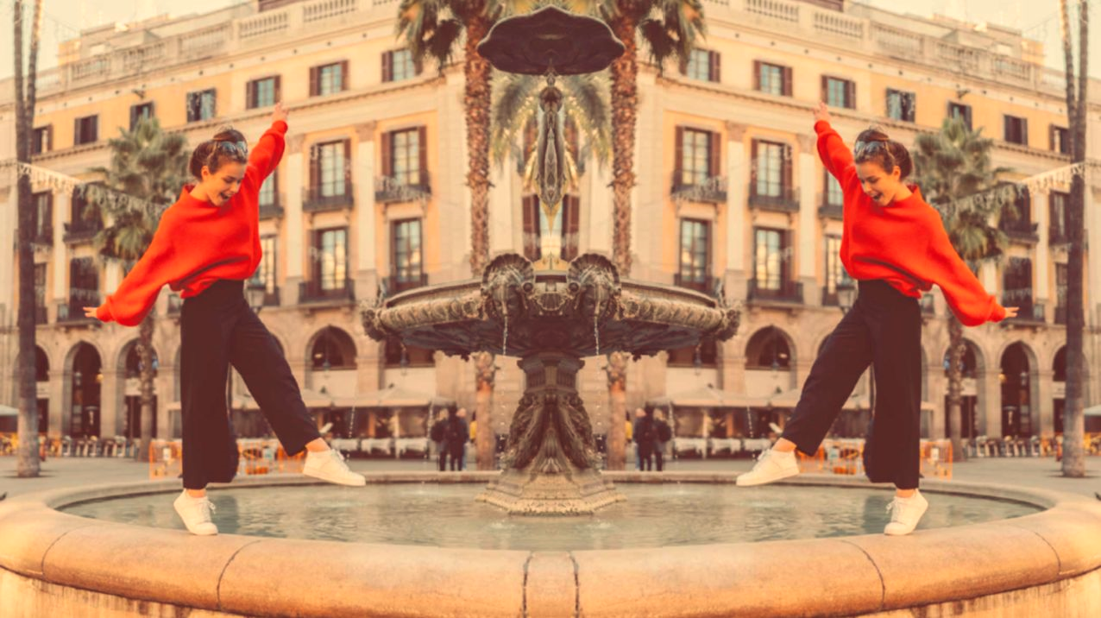
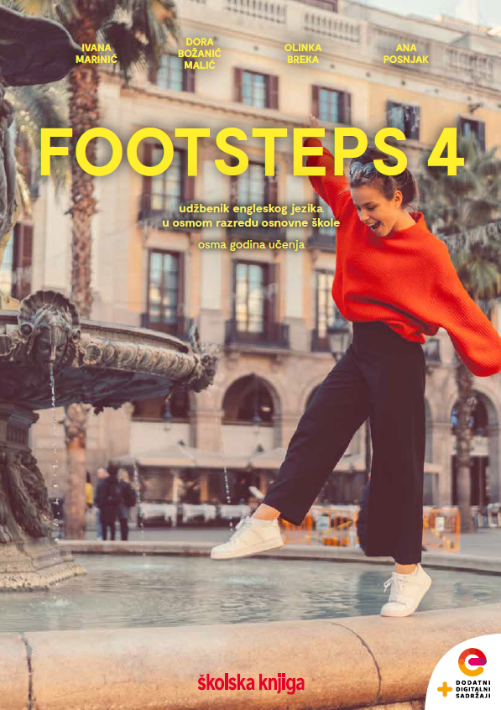

UNIT 4;
All over the map
Self-check 4

Slide 2
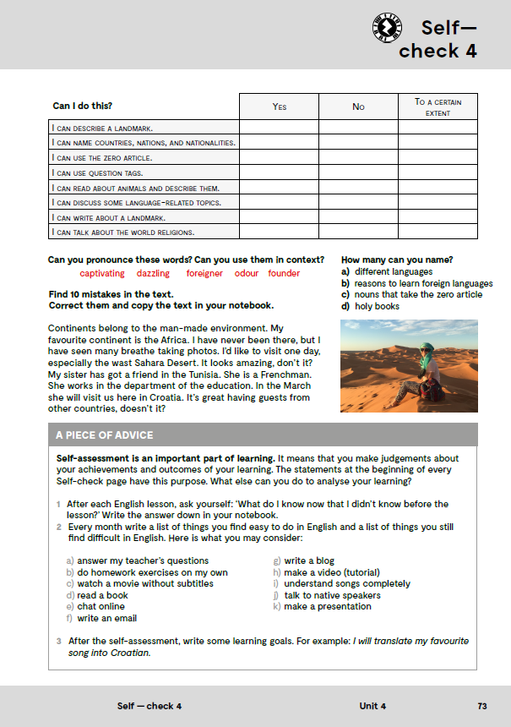
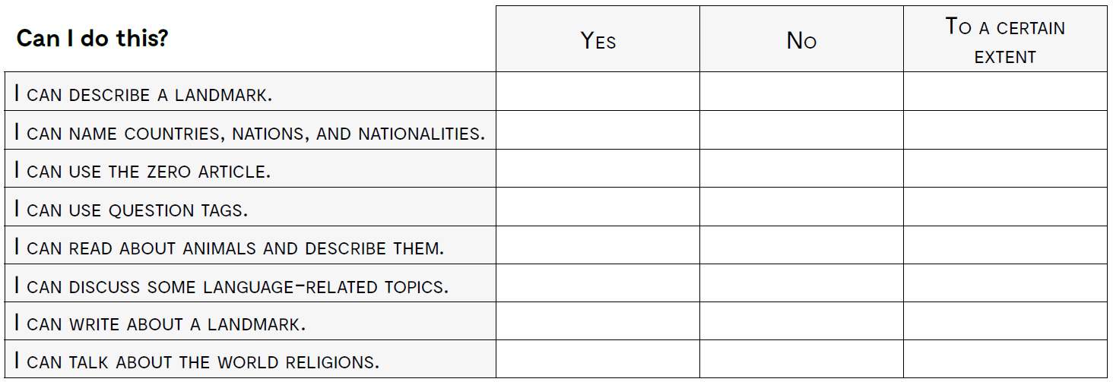
opisati poznatu znamenitost
imenovati zemlje, nacije i nacionalnosti
govoriti o vlastitim iskustvima
ispravno koristiti članove
koristiti upitne fraze za provjeru već izrečenog
čitati o životinjama i opisivati ih
raspravljati o temama vezanim uz jezike
pisati o znamenitostima
razgovarati o svjetskim religijama

Slide 3
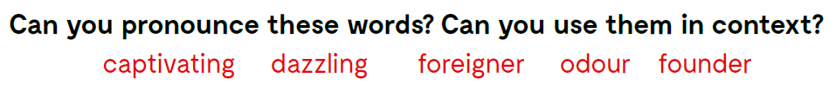
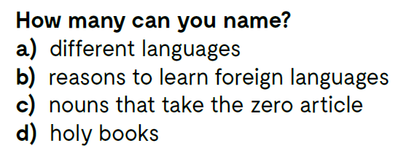
Can you pronounce these words? Can you use them in context?

Slide 4
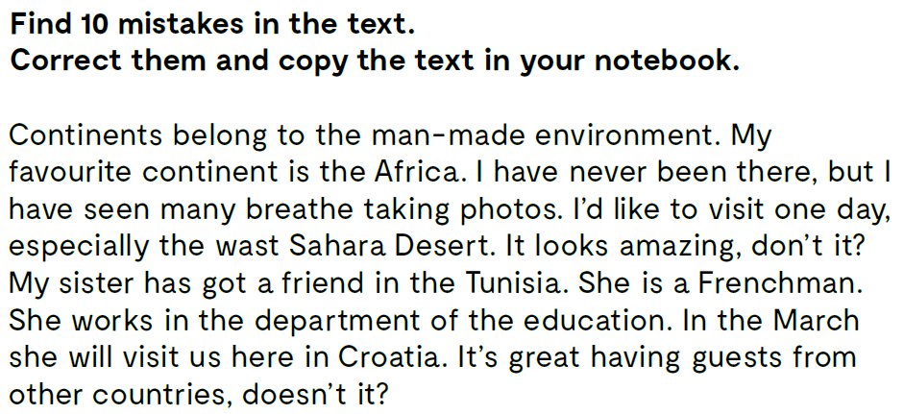
Continents belong to the natural environment.
My favourite continent is the Africa.
I have never been there, but I have seen many breathtaking photos.
I’d like to visit one day, especially the vast Sahara Desert.
It looks amazing, doesn’t it?
My sister has got a friend in the Tunisia. She is a Frenchwoman.
She works in the department of the education.
In the March she will visit us here in Croatia.
It’s great having guests from other countries, isn’t it?

Slide 5
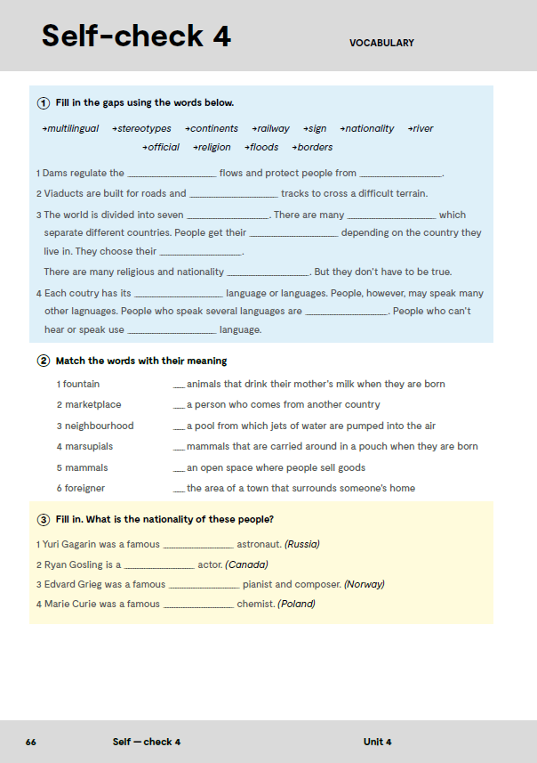
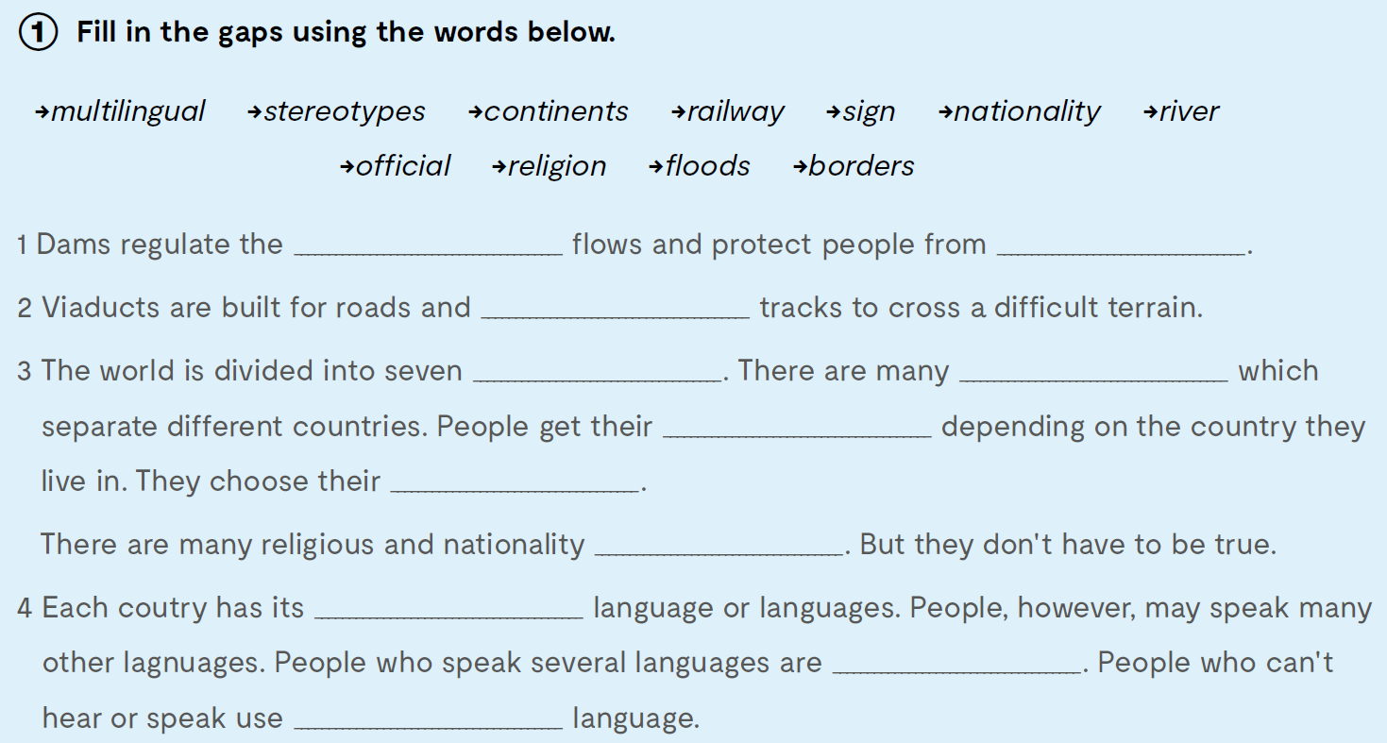
workbook, page 66.
Fill in the gaps using the words below.
river
floods
railway
continents
borders
nationality
religion
stereotypes
official
multilingual
sign

Slide 6
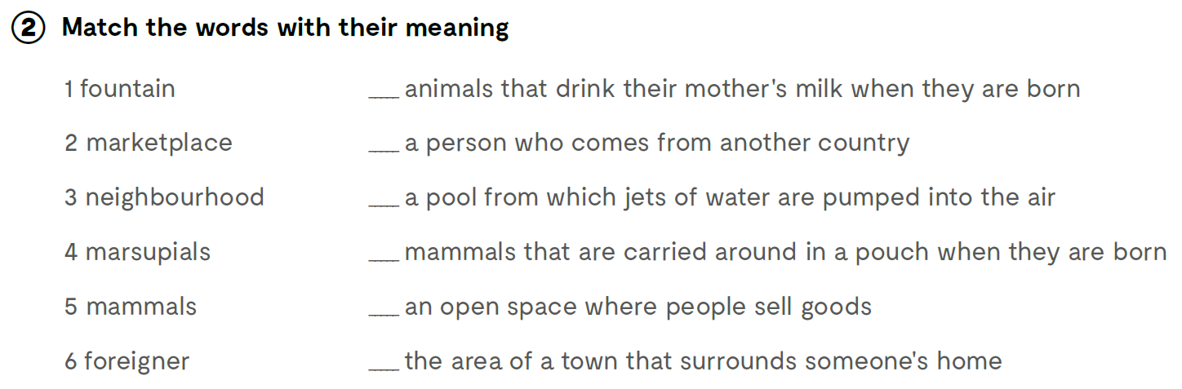
Match the words with their meaning.
5
6
1
4
2
3

Slide 7
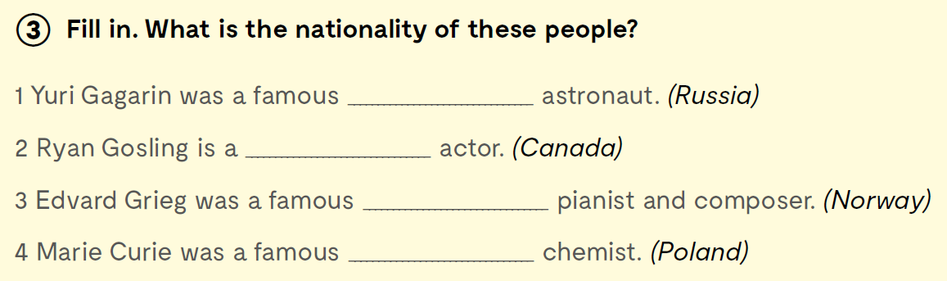
Fill in. What is the nationality of these people?
Russian
Canadian
Norwegian
Polish

Slide 8
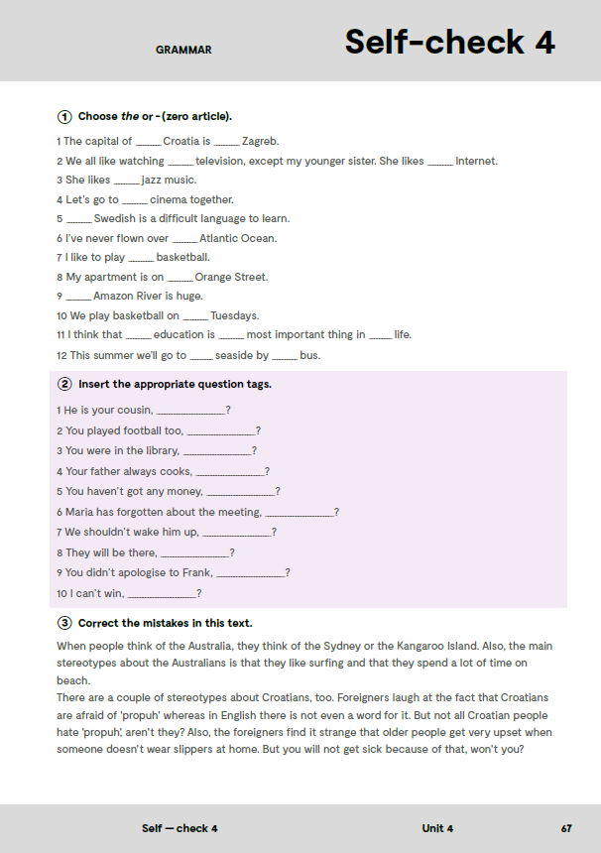
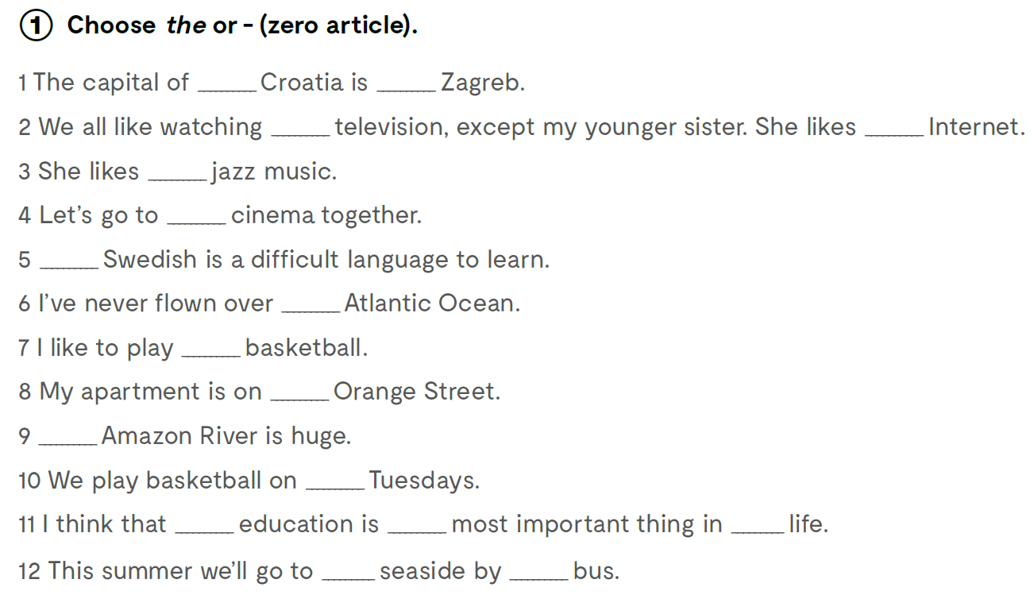
Chose the or – (zero article).
-
-
-
the
-
the
-
the
-
-
The
-
-
the
-
the
-

Slide 9
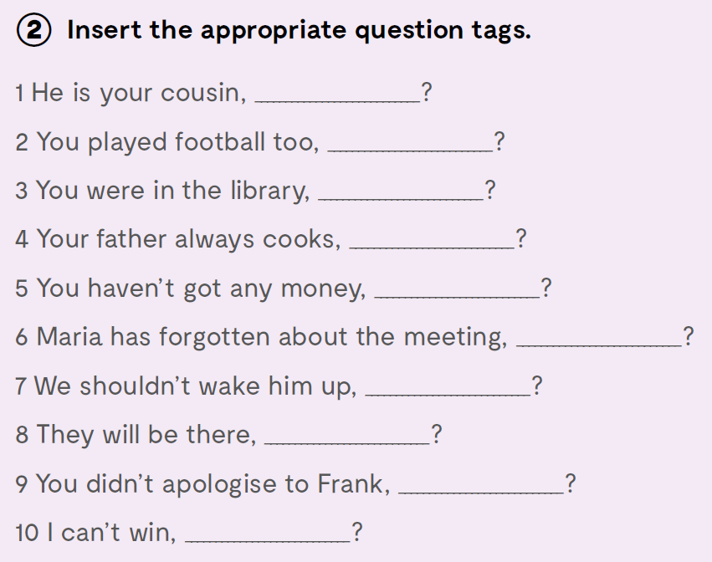
Insert the appropriate question tags.
isn’t he
didn’t you
weren’t you
doesn’t he
have you
hasn’t she
should we
won’t they
did you
can I

Slide 10

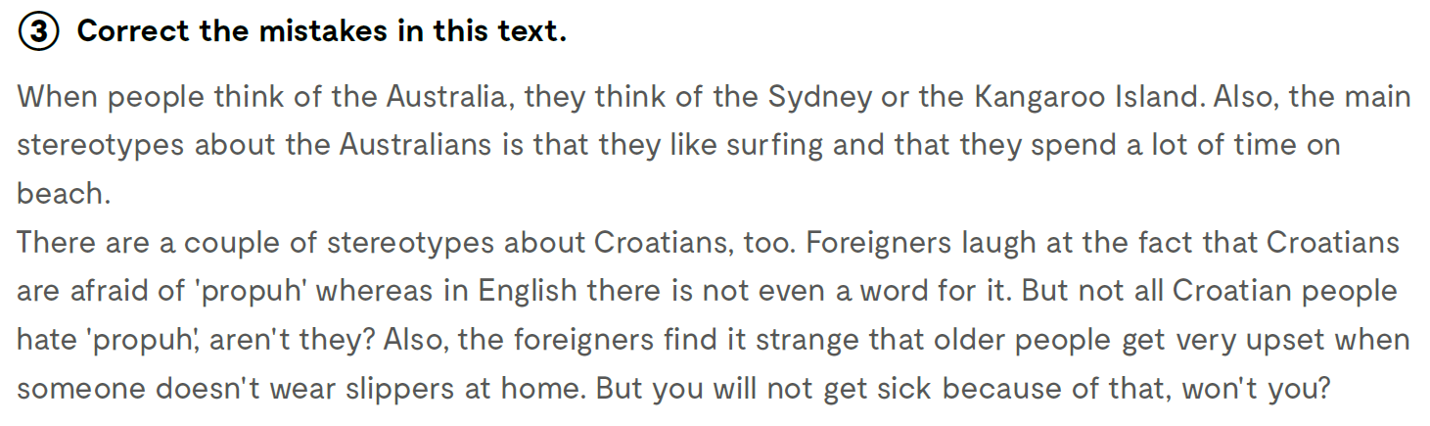

Correct the mistakes in this text.
are
do
will

Slide 11
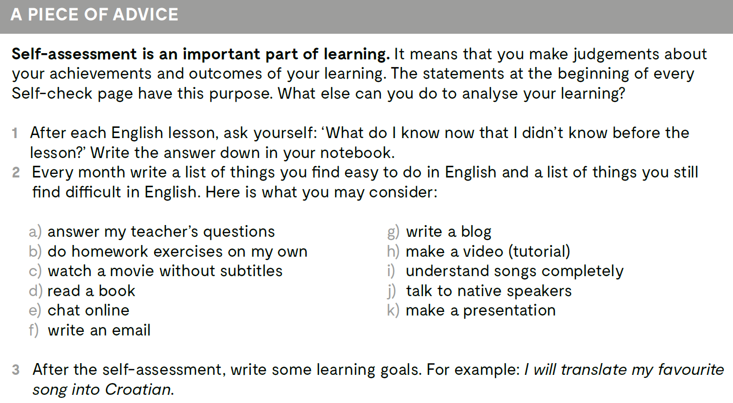
Self-assessment is an important part of learning. It means that you make judgements about your achievements and outcomes of your learning.
Check what you have learnt
https://www.bookwidgets.com/play/RB97ZRP

